Slide 1

what to say and when:
PROGNOSTICATION AT THE EDGE OF KNOWING
Palliative Medicine in Advanced Heart Failure
W. Greg Mullinax, MD FAAFP

Slide 2
W. Greg Mullinax, MD, FAAFP
    Dr. Greg Mullinax received his training in Family Medicine at Ventura County Medical Center in Ventura California prior to moving to Memphis in 2002 to begin working with Christ Community Health Services. He practiced full scope family medicine, including surgical obstetrics, for 14 years before deciding to pursue training in Palliative Medicine. He held the positions of Director of Women’s Health Services at Christ Community and Service Chief of Family Medicine at Regional One Health prior to joining Baptist Medical Group August 2017. He completed a fellowship in Hospice and Palliative Medicine at the University of Tennessee and is boarded in Family Medicine and Hospice and Palliative Medicine. He is the Director of Palliative Medicine at Baptist Memorial Hospital, Memphis. He is happily married to Dr. Clarice Mullinax and has two teenage children.
No financial disclosures

Slide 3

Objectives
Prognostication: Utilize labs, clinical signs, and disease trajectories to assist in evidence based prognostication in medically complex advanced heart failure patients
Incorporate Primary Palliative Medicine: Utilize specific communications tools when delivering news about serious illness to help develop prognostic awareness in patients with advanced heart failure and their families/ care-givers
Complex Medical Uncertainty: Become familiar with a standardized model for approaching complex ethical situations

Slide 4
Palliative Medicine: A Definition
  Palliative medicine is a medical specialty focused on relieving suffering and improving quality of life for patients with life-limiting illnesses.
    In-hospital palliative consults are called for patients with complicated pain, distressing symptoms, complex diagnoses, and for patients and/or families facing complex decisions.
    Palliative medicine provides interdisciplinary care for patients with an approach that addresses the whole person: physically, mentally, and spiritually.
    Palliative medicine can be received concurrently with disease-modifying treatments.
    The interdisciplinary team includes (but is not limited to) physicians, nurse practitioners, advanced practice nurses, social workers, and chaplains.
    Center to Advance Palliative Care (CAPC), Independent National Marketing Survey, 2011

Slide 5
A 30 second Palliative definition
Palliative Care focuses on improving quality of life by
reducing the suffering from physical symptoms
and the stress of serious illness
at any stage of a disease.
Palliative description for patients and families
Notes:
An easy transition into a palliative consult for primary teams could be, “ we have a team in the hospital who specializes in symptom management and chronic illness. I would like them to participate as part of our treatment team to see if they can assist you in any way.”

Slide 6
THE BURDEN OF ADVANCED HEART FAILURE
An estimated 20 million persons worldwide are affected by HF and the prevalence has doubled in the last 25 years and is expected to double again between 2030 and 2040.
          (Kirkpatrick et al., Ventricular assist devices for the treatment of acute heart failure and chronic heart failure, Heart 2015;101:1091–1096)
An estimated 5.7 million individuals in the United States are currently diagnosed with HF, a number that is expected to grow to >8 million by 2030.
Of these, an estimated 5% of patients have end-stage/Stage D HF, and have a significantly diminished quality of life (QOL).
            (American Heart Association Statistics Committee and Stroke Statistics Subcommittee. Heart disease and stroke statistics/2017update)
Only a portion of these patients will receive a heart transplant or ventricular assist device.
The majority of patients with advanced heart failure, without transplant or ventricular assist devices will die from or with HF.
Heart Failure (HF) is a chronic disease of significant morbidity and mortality, with a 5-year prognosis similar or worse than most cancers.
(Stewart S. MacIntyre et. al. More Malignant than Cancer? Five year survival following a first admission for heart failure. Our J Heart Failure 2001;3:315-322)

Slide 7
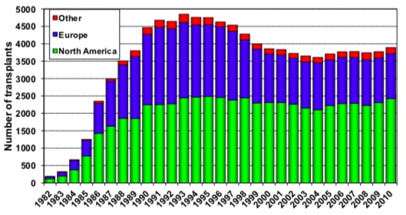
THE BURDEN OF ADVANCED HEART FAILURE
The use of durable LV assist devices (LVADs) in chronic HF has increased dramatically, with up to 2511 implants in 2013 in the USA.
          (Kirkpatrick et al., Ventricular assist devices for the treatment of acute heart failure and chronic heart failure, Heart 2015;101:1091–1096)
Between 2005 and 2016, the number of new active listing for heart transplant increased 57%; HOWEVER, the number of candidates actively awaiting heart transplant also increased dramatically over the same period (127%) suggesting that transplant rates have not increased at the same pace.
                (2016 Annual Cardiac Transplant US Statistics, American Society of Transplant Surgeons)
Stehlik, et al, J Heart Lung Transplant. 2010 Oct;29(10):1089-1103

Slide 8
EVIDENCE FOR THE BENEFIT OF PALLIATIVE CARE IN ADVANCED HEART FAILURE
  In Randomized Clinical Trials Advanced Heart Failure Patients were randomized to receive Usual Care Alone verses Palliative Medicine + Usual Care:
  Palliative care helped at one month with CHF symptoms and depression in patients randomized to receive palliative care regardless of expected prognosis.
    (Sidebottom AC, Jorgenson A, Richards H, et. al. Inpatient palliative care for patients with acute heart failure: outcomes from a randomized trial. J Palliative Med 2015;18:134-42)
  Patients receiving ongoing palliative care showed statistical improvement in physical symptoms: as seen in patient reported disease specific outcomes (p=0.037) (using the KCCQ: Kanasas City Cardiomyopathy questionnaire)
  Patients receiving ongoing palliative care showed statistical improvement in psychological symptoms as well: as seen in patient reported Quality of Life (QoL) assessments (p=0.046) (using the FACIT-Pal: The Functional Assessment of Chronic Illness Therapy
  Patients receiving ongoing palliative care showed improvements in spiritual well being (p=0.027), and demonstrated less anxiety (p=0.048) and less depression (p=0.020)
  Patients receiving palliative care had no higher mortality than those receiving usual care alone.
                (Rodgers,J.G.,MD, et,al, Palliative Care in Heart Failure, Pall-HF, J Am Coll Cardiol 2017;70:331-41)
  However, in one VA study of 384 participants: Higher depression rates were correlated with increased mortality at one year in matched HF patients.
  (Hillary D. Lum, MD, et. al.Physical and Depressive Symptoms Predict Heart Failuree–Specific Health Status Over One Year. J Pain Symptom Manage. 2016 June ; 51(6): 963–970)

Slide 9
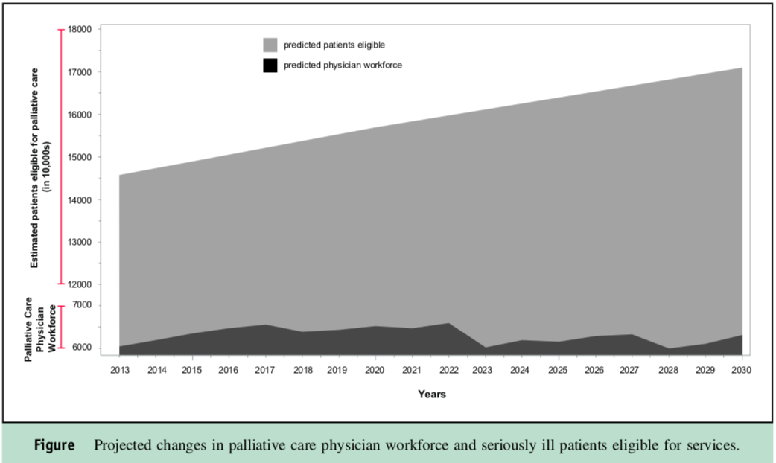
SPECIALTY PALLIATIVE MEDICINE SHORTAGE
There is a shortage of board certified palliative medicine physicians in the United States.
Current estimates report there are 6600 board certified palliative medicine physicians currently in practice in the US
This represents an estimated shortage of 18,000 physicians (based on optimal needs for specialists)
There are less than 250 fellowship-trained physicians entering the field annually secondary to limited fellowship slots
This results in an estimate of only one palliative medicine physician for every every 26,000 patients by 2030.
Kamal,Arif H. MD, MBA,MHS, et al, Future of Palliative Care Workforce:Preview to an Impending Crisis, The Am Jour of Medicine, Vol130,(2), Feb 2017

Slide 10
CORE COMPONENTS OF A PALLIATIVE MEDICINE CONSULT
Goals of Care
What have you heard the doctors say about your illness? What are you hoping for?
Code Status or Advanced Care Planning
If you ever could not talk for yourself, who would you want to seek for you?
Shared Medical Decision Making
What is the main medical decision that you and the medical team are facing?
Symptom Management
What makes a good day for you? What hinders you from this?
Information Sharing
Some people like to receive information as a big picture and some like the details. How do you like to receive it?
Spiritual Assessment/ Existential Concerns
Where do you find your strength or support? Are you at peace?
Quality of Life Assessment
What matters most to you?
Legacy Building
What do you want your loved ones to know?
Notes:
What should you expect in a palliative consult? Key questions and patient examples.
Shared Medical Decisions: Paul Kalanithi
Information Sharing: By asking patients how they want to receive information you invite them also to tell you if they want to receive it
Legacy Building: Jessica

Slide 11
PRIMARY PALLIATIVE MEDICNE
Assuring the patient understands his/her illness and prognosis
Establishing the goals of medical care:
    Discussions regarding goals of care take into account the patient’s illness, the illness trajectory and the patient’s values and goals so that patients can make decisions consistent with their values and goals
Assessment of the patient’ physical and nonphysical symptoms
Ahia,Chad L., MPH, Primary Palliative Care for the General Internist: Integrating Goals of Care Discussions in the Outpatient Setting, The Oshner Journal,14: 704-711, 2014

Slide 12
BARRIERS TO INTEGRATING PRIMARY PALLIATIVE MEDICINE IN THE CARE OF ADVANCED HEART DISEASE
Lack of Familiarity of Primary Palliative Care
Misconceptions of Palliative Medicine
Misconception of Hospice
Time constraints with increased work loads
Uncertain disease trajectory of heart failure
Discomfort with difficult conversations

Slide 13
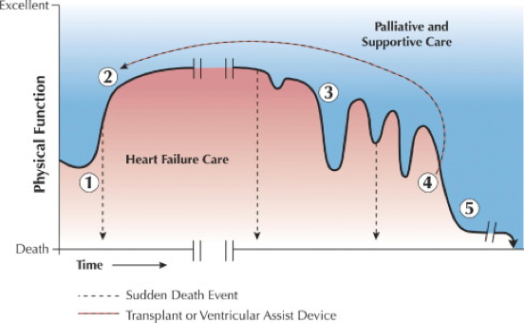
UPDATED DISEASE TRAJECTORY IN HEART FAILURE
Schematic Trajectory of Heart Failure Symptoms. Goodlin SJ.

Slide 14
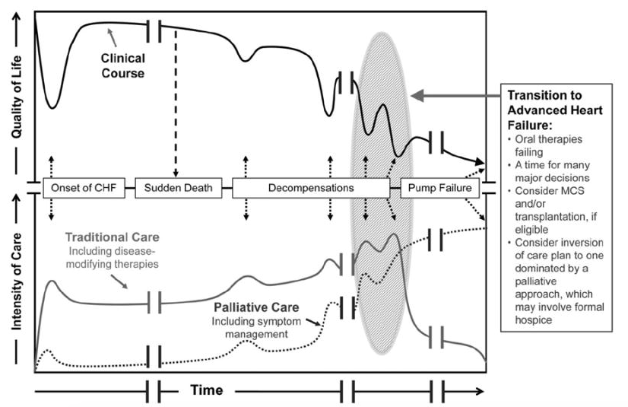
INCORPORATING PALLIATIVE MEDICINE INTO THE UPDATED HEART FAILURE DISEASE TRAJECTORY
Circulation. 2012 Apr 17; 125(15): 1928–1952

Slide 15
Prognostic Awareness : Key to Primary Palliative Discussions
Definition of Prognostic Awareness: The patient’s or family’s capacity to integrate the likely disease trajectory with the prognosis.
Cultivating Prognostic Awareness
Hope
Realism
Patients and families integrate information both cognitively and emotionally
Vicki A. Jackson, MD, MPH et. al. The Cultivation of Prognostic Awareness Through Early Palliative Care IN the Ambulatory Setting: a Communication Guide. J Pall Med.Vol.16:8.2013

Slide 16
Keys to Primary Palliative Discussions: WHEN TO START
Look For Triggers for Discussion
  Increased symptom burden or decreased quality of life
  Significant decrease in functional capacity (Loss of ADLs, Falls, Transitions in living situation)
  Worsening HF: recurrent hospitalizations
  Serial increases in maintenance dose of diuretics
  First or Recurrent ICD shocks for VT/VF
  Initiation of intravenous inotropic therapy
  Consideration of renal replacement therapy
Circulation. 2012 Apr 17; 125(15): 1928–1952

Slide 17
PROGNOSTICATION IN HEART FAILURE
Challenges for providing accurate 6-12 month mortality
The high incidence of sudden death along the HF disease trajectory (25-50%)
Disparities in the application of evidence-based treatment guideline constituting Optimal Medical Management (OMM)
Inter-observer differences in the NYHA classification
Heterogenous study populations in the HF literature
Reisfield MD, Prognostications Heart Failure, Palliative Medicine Fast Facts #143, https://www.mypcnow.org/blank-fj2d4, visited 2/16/19

Slide 18
PROGNOSTICATION IN HEART FAILURE: Evolving Interventions
Expanding Options for those with “End Stage” Heart Failure
Medical Approaches: Optimal Medical Management (OMM), Inotropic Support (of note: original studies showing increased risk of sudden death performed prior to era of commonly utilized AICD)
Surgical Approaches: Revascularization, Mitral Valve Repair, TAVR, Mechanical Circulatory Support, Transplant
Regenerative Approaches: Cell-Based Therapy, Gene Therapy
Improving Techniques for Palliative Symptom Management

Slide 19
PROGNOSTICATION IN HEART FAILURE
One Year Mortality for NYHA Classes:
      (Based on data from the SUPPORT, Framingham, and IMPROVEMENT studies)
    Class II : 5-10% (mild symptoms, slight limitation during ordinary activity, no symptoms at rest)
    Class III : 10-15% (moderate symptoms, physical activity is markedly limited)
    Class IV : 30-40% (severe symptoms that negate many activities and symptoms at rest)
General Predictors of Shorter One Year Mortality Rates
    Cardiac Hospitalizations: Triples the one year mortality rate (1 in 10 die in 30 days)
    Intolerance of optimal medical management (B-blockers, ACE-I, ARBs) increases 4 month mortality rate
    SBP<100 : doubles one year mortality rate
    Other related conditions that increase one year mortality rate:
Decreased EF< 45% | Ventricular Arrythmias | Anemia
Heart Rate > 100 | Persistent Hyponatremia (<136) | Creatinine > 1.4

Slide 20
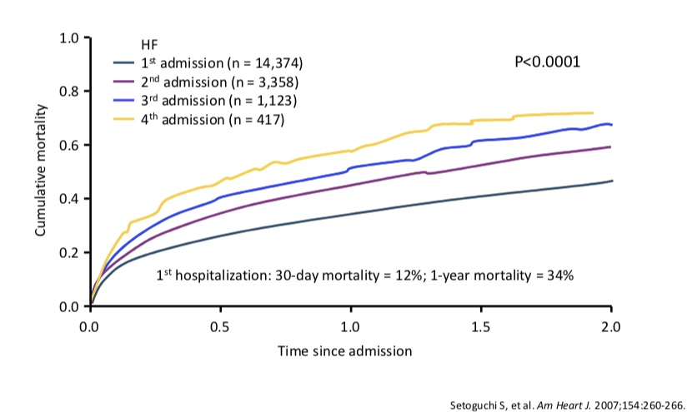
PROGNOSTICATION IN HEART FAILURE
General Predictors of Shorter One Year Mortality Rates cont.

Slide 21

PROGNOSTICATION IN HEART FAILURE: Correlating Prognostic Scales
NYHA Class IV has been shown to be equivalent to a Karnofsky Performance Status (KPS) of 50 and an ECOG Score of 3
Karnofsky Status | Karnofsky Grade | ECOG Grade | ECOG Status
Normal, no complaints | 100 | 0 | Fully Active, able to carry on all disease performanceperfomance without restriction
Normal Activities, Minor signs of disease | 90 | 1 | Restricted in physical strenuous activity but ambulatory and able to carry out work of light or sedentary nature
Normal Activity but with effort | 80
Cares for self. Unable to carry on normal activity or to do active work | 70 | 2 | Ambulatory and capable of all ADLs but unable to carry out any work activities. Up and about more than 50% of waking hours
Requires occasional assistance, but able to perform most ADLs | 60
Requires considerable assistance and frequent medical care | 50 | 3 | Capable of only limited ADL. Confined to Bed or Chair more than 50% of waking hours
Disabled. Requires special care and assistance | 40
Severely Disabled. Hospitalization indicated though death nonimmenent | 30 | 4 | Completely disabled. Cannot carry on any ADL. Totally confined to bed or chair
Very sick. Hospitalization necessary. Active Supportive treatment necessary. | 20
Moribund | 10
Dead | 0 | 5 | Dead
Johnson, The relationship between two performance scales: New York Heart Association Classification and the Karnofsky Performance Status Scale, J Pain Symptom Management, 2014 Mar;47(3)652-658
A Karnofsky score < 40 or an ECOG > 3 roughly correlates with a median survival of 3 months

Slide 22
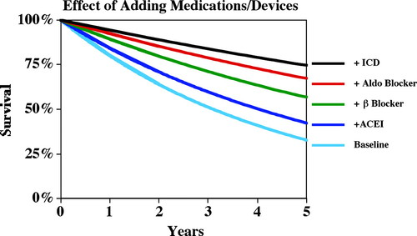
PROGNOSTICATION IN HEART FAILURE: Correlating Prognostic Scales
The NYHA classification remains the major gauge of disease severity but not of prognosis. There fore it is worth using Karnofsky Performance Scale (KPS) to measure performance status in Heart Failure Patients
Seattle Heart Failure Model (SHFM)
    This validated and accepted model continues to evolve and takes into account easily obtained clinical characteristics:
  A better gauge of prognosis: Predicts 1,2,3 year mortality
  Age, Gender, NYHA class, Weight, EF, SBP, Medications (OMM), Specific Diuretics, HgB, Sodium, Total Chol., Lymphocytes, and support devices (BiV Pacer, ICD, BiV ICD, LVAD)
  Can demonstrate change bases on addition or absence of certain interventions
Levy, MD, et. al, The Seattle Heart Failure Model Prediction of Survival in Heart Failure, Circulation. 2006;113:1424-1433

Slide 23
Hospice Criteria in Heart Failure
Hospice Guidelines:
(Medicare Hospice Eligibility Requirement and Hospice Local Coverage Determination, LCD)
(National Hospice and Palliative Care Organization, NHPCO)
Palliative Performance Score < 70
Karnofsky score <50
NYHA: Class IV
Patient is not a candidate for or has declined a surgical procedure
Patient is or has already been treated with optimal medical management (OMM) for heart disease and either has decline on OMM or is unable to tolerate
Systolic CHF with EF<20%
Diastolic CHF with symptoms of angina or dyspnea at rest
Treatment resistant symptomatic supra ventricular or ventricular arrhythmia
Past history of cardiac arrest or resuscitation
Past history or unexplained syncope
Cerebral embolic complications of cardiac origin
LCD Guidelines were created in 1996 as a GUIDE to be used in conjunction with clinical judgement but was never intended to become public policy. It was never validated and has been shown to be poorly predictive of prognosis
Fox et al., JAMA 1999; 282:1638-1645
Baseline Health
One of the following should be present
Must Be Present
Supporting criteria (not required)

Slide 24
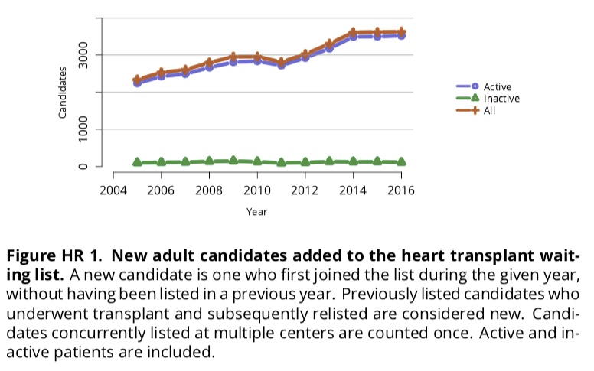
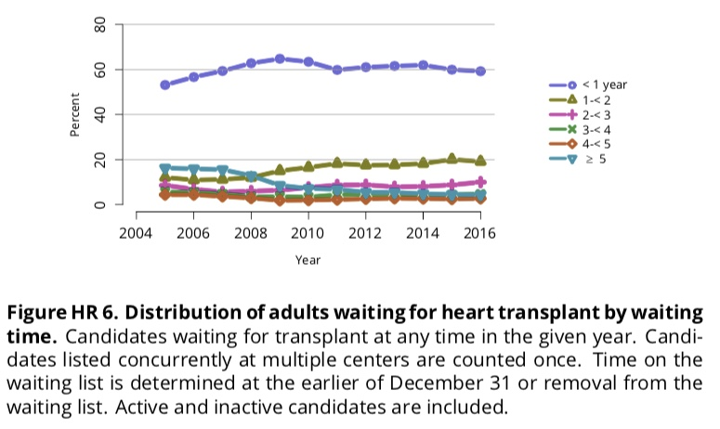
PROGNOSTICATION IN HEART FAILURE: Shifting Sands
Increasing numbers and increasing waitlist times for patient awaiting heart transplants necessitate a change in the UNOS wait list categories

Slide 25
PROGNOSTICATION IN HEART FAILURE: Shifting Sands
New UNOS (United Network for Organ Sharing) Transplant Statuses (Status Criteria)
Old | New
Status 1A : designated for candidates on the waiting list who have the highest priority on the basis of medical urgency. Patients may be listed as Status 1A for 30 days at any time after LVAD implantation when they are clinically stable. Patients who are experiencing LVAD-related complications, such as infection, thromboembolism, or device malfunction, may also be listed as Status 1A. Status 1B : Patients who are supported by an LVAD but who do not meet the aforementioned criteria are listed as Status 1B. Status 2 does not apply to patients with LVADs. | Status 1 : ECMO/ Continuous Mechanical Ventilation/ Non-dischargeable surgically implanted VAD/ MCSD with Life-threatening ventricular arrhythmia Status 2 : IABP/ Ventricular Tachycardia, ventricular fibrillation, MSC not required/ MSCD with malfunction or mechanical failure/ Total artificial heart/ Dischargeable BiVAD or RVAD/ Acute Circulatory Support Status 3 : Dischargeable LVAD for up to 30 days/ Multiple inotropes or single high-dose inotropes with continuous hemodynamic monitoring/ MCSD with device infection/ MCSD with hemolysis/ MCSD with pump thrombosis/ MCSD with right heart failure/ MCSD with mucosal bleeding/ MCSD with aortic insufficiency/ Stable LVAD candidates not using 30 day discretionary period/ Inotropes without hemodynamic monitoring/ Diagnosis of congenital heart disease (CHD)/ Diagnosis of ischemic heart disease with intractable angina Status 4 : Diagnosis of hypertrophic cardiomyopathy/ Diagnosis of restrictive cardiomyopathy/ Diagnosis of amyloidosis/ Retransplant Status 5 : Combined organ transplants Status 6 : All remaining active candidates

Slide 26
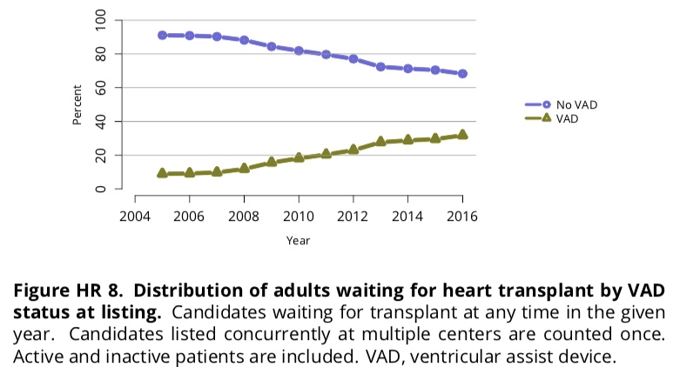
PROGNOSTICATION IN HEART FAILURE: Shifting Sands
INTERMACS categories created for the most complicated hospitalized patients with HF (NYHA IV) to optimized advanced heart therapy selection
Increasing numbers of patients are being considered for advanced circulatory support
Numbers of patients bridging to transplant increases

Slide 27
PROGNOSTICATION IN HEART FAILURE: Shifting Sands
INTERMACS
(International Register for Mechanically Assisted Circulatory Support)
Improved communication for patients requiring MCS in NYHA Category IV Classification and designed to capture the larger spectrum of disease severity with in the NYHA Class IV category to optimize advanced therapy selection
Hospitalized Levels
  Level 1: Critical cardiogenic shock describes a patient who is ‘‘crashing and burning,’’ in which a patient has life-threatening hypotension and rapidly escalating inotropic pressor support, with critical organ hypoperfusion often confirmed by worsening acidosis and lactate levels.
  Level 2 : Progressive decline, ’‘dependent’’ on inotropic support but with continued decline and with deterioration in nutrition, renal function, fluid retention, or other major status indicators. Patients may have refractory volume overload, impaired perfusion, and difficulty being maintained on inotropic infusions owing to tachyarrhythmias, clinical ischemia, or other intolerance.
  Level 3 : Clinically stable but inotrope dependent, on mild to moderate doses of intravenous inotropes (or has a temporary circulatory support device) after repeated failure to wean without symptomatic hypotension, worsening symptoms, or progressive organ dysfunction (usually renal). It is critical to monitor nutrition, renal function, fluid balance, and overall status carefully to distinguish between a patient who is truly stable at patient profile 3 and a patient who has unappreciated decline rendering them patient profile 2.

Slide 28
PROGNOSTICATION IN HEART FAILURE: Shifting Sands
INTERMACS
(International Register for Mechanically Assisted Circulatory Support)
AMBULATORY LEVELS
  Level 4: Resting symptoms or shortness of breath with activities of daily living but at home on oral therapy. Patients may have gastrointestinal symptoms (abdominal discomfort, nausea, poor appetite), disabling ascites, or severe lower extremity edema. This patient should be carefully considered for more intensive management and surveillance programs, by which some may be recognized to have poor compliance that would compromise outcomes with any therapy.
  Level 5: Exertion/exercise intolerant but is comfortable at rest, living predominantly within the house or housebound. This patient has no congestive symptoms but may have chronically elevated volume status, frequently with renal dysfunction.
  Level 6: Exertion limited but comfortable at rest without evidence of fluid overload, but who is able to do some mild activity. Activities of daily living are comfortable and minor activities outside the home such as visiting friends or going to a restaurant can be performed, but fatigue results within a few minutes of any meaningful physical exertion. This patient has occasional episodes of worsening symptoms and is likely to have had a hospitalization for heart failure within the past year. This category describes NYHA class III.
  Level 7: Advanced NYHA class III describes a patient who is clinically stable with a reasonable level of comfortable activity, despite a history of previous decompensation that is not recent. This patient is usually able to walk more than a block. Any decompensation requiring intravenous diuretics or hospitalization within the previous month should make this person a patient profile 6 or lower.

Slide 29
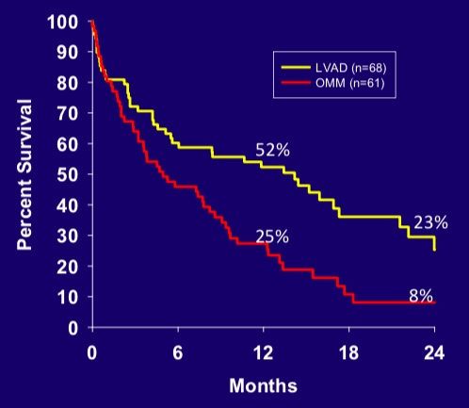
PROGNOSTICATION IN HEART FAILURE: Shifting Sands
REMATCH Trial
(Randomized Evaluation of Mechanical Assistance for the Treatment of Congestive Heart Failure)
RCT (n=129) of Non-transplant candidates comparing OMM vs pulsatile flow LVAD
EF<25%, Peak vO2<12ml/kg/min, on continuous infusion inotropes
Increased survival
The frequency of serious adverse events (AE) in the device group was 2.35 (95 per- cent confidence interval, 1.86 to 2.95) times that in the medical-therapy group
AE showed a predominance of infection, bleeding, and malfunction of the device.
The quality of life was significantly improved at one year in the device group but not equal to normal population baselines.
FDA approved DT
N Engl J Med 2001;345:1435-1443

Slide 30
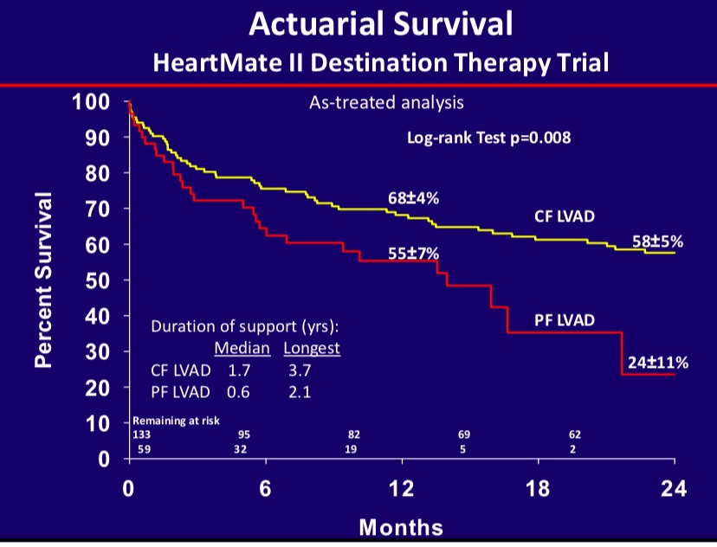
PROGNOSTICATION IN HEART FAILURE: Shifting Sands
Comparison of Continuous Flow to Pulsatile flow for DT (Destination Therapy)
Non-transplant eligible patients were randomized 2:1 ration for CF LVAD vs Pulsatile flow
End point was two year survival free from disabling CVA.
Secondary endpoints were AE, QoL, and Functional Capacity
Slaughter MS, Rogers JG, Milano CA, et al., for the HeartMate II Investigators. Advanced heart failure treated with continuous-flow left ventricular assist device. N Engl J Med 2009; 361:2241–51.

Slide 31
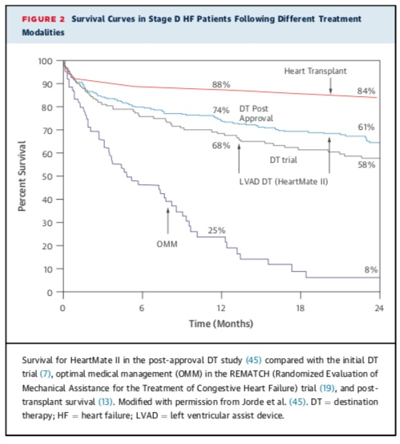
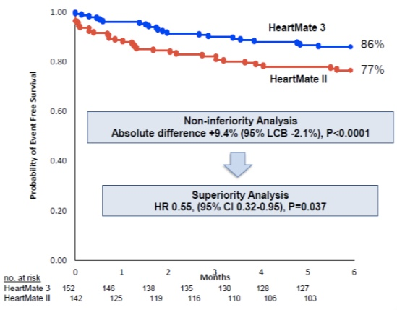
PROGNOSTICATION IN HEART FAILURE: Shifting Sands
Comparison of survival of advanced CF LVAD and Transplant
Mehtra, MD et al, A Fully Magnetically Levitated Circulatory Pump for Advanced Heart Failure, N Engl J Med 2017;376:440-50
Mancini, MD, et al, Left Ventricular Assist Devices, A Rapidly Evolving Alternative to Transplant, J Am Col Cardiology,Vol65.(23)2015

Slide 32
PROGNOSTICATION IN HEART FAILURE: Shifting Sands
Long-term Complications (Adverse Events- AE) Associated with CF-LVADs
Driveline infections (19%)
Sepsis (19%)
Strokes (11.7%)
Thrombus formation (3.6%)
Bleeding (54%)
Mechanical failures requiring replacement (4%)
Right HF (18%)
Acquired von Wille- brand’s disease rapidly develops in virtually all patients post–CF-LVAD implant
Aortic insufficiency is also frequent, with an incidence of >30% at 3 years.
The event rate in device-supported patients resulting in rehospitalization for infection, bleeding, device malfunction, stroke, or death is extremely high, at 70% in the first year
Mancini, MD, et al, Left Ventricular Assist Devices, A Rapidly Evolving Alternative to Transplant, J Am Col Cardiology,Vol65.(23)2015

Slide 33
PROGNOSTICATION IN HEART FAILURE: Shifting Sands
With Improving LVAD Survival Should LVADs be considered for Ambulatory HF patients prior to dependence on inotropes? (INTERMACS 4-7)
Less than 20% of current LVAD device implantation occurs in patient prior to inotrope dependence
MedaMACS: (Medical Arm for Mechanically Assisted Circulatory Support) is a specialized registry of medically managed patients who meet INTERMAC 4 criteria for HF (Survival 47% at 12 mo)
In the ROADMAP Trial (Risk Assessment and Comparative Effectiveness of Left Ventricular Assist Device and Medical Management in Ambulatory HF Patients) MedaMACS patients were followed with OMM and compared to patients in the same classification who elected LVAD implantation
    Primary end point was survival at one year which were roughly equivalent (63% at 12 mo)
    QoL measures were higher in the LVAD treated arm at the same time as increased adverse events, predominantly bleeding
    2 year outcomes show survival equivalencies as well highlighting the need to take into account more than survival in the decision of therapy
Stewart, et al. Defining Ambulatory Advanced Heart Failure: MedaMACS and Beyond, Circ Heart Failure Rep (2017)14:498-506

Slide 34
PROGNOSTICATION IN HEART FAILURE: Shifting Sands
Quality of Life Assessment of Transplant Patients at the 10 year mark
Overall one-year survival (2009-2011)was 90.1%
3-year survival 83.5%
5-year survival 78.3%
10-year survival 45%
Most common cause of death in the first year post transplant was infection
By the second year, cardiovascular/cerebrovascular disease was the leading documented cause of death through year 5 and beyond reaching 100% occurrence of CAD by year 20.
Quality of Life (QoL) measures are often separated into physical (PCS) and Mental (MCS) measures.
Transplant recipients often report lower PCS scores but MCS scores comparable to the general population
2016 Annual Cardiac Transplant US Statistics, American Society of Transplant Surgeons
Politi. et al., Ten Years of “Extended” Life: Quality of Life Among Heart Transplant Survivors, Transplantation.Vol78(2)2004

Slide 35
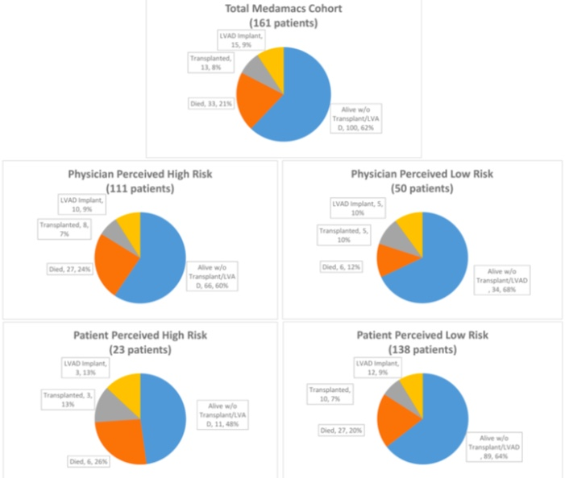
Discordant Perceptions of Prognosis
Discordant Perceptions of Prognosis and Treatment Options between Physicians and Patients with Advanced Heart Failure
    Ambardekar, et al. JACC Heart Fail. 2017 September ; 5(9): 663–671

